Slide 1
The History of Ireland
British/Irish
Protestant/Catholic
English/Gaelic

Slide 2
Before we go on with the history of Ireland, you need to rack your brains to remember some of English history. Remember Henry VIII? When he became king, England was Catholic & had been for some time. He wanted to divorce his first wife, Catherine of Aragon, to marry Anne Boleyn. The pope said no. So Henry declared the Church of England to be separate from the Catholic church & named himself the head of it.
Strangely, history.com (https://www.history.com/topics/reformation) states that “in northern and central Europe, reformers like Martin Luther, John Calvin and Henry VIII challenged papal authority and questioned the Catholic Church’s ability to define Christian practice.” It’s hard to imagine why anyone would put Henry VIII & Martin Luther in the same category. Henry obviously had no interest in being a reformer, just in casting off a wife & marrying someone who might be able to give him a son. But his self-interest coincided with the time of the Reformation, & that led to a power struggle in the name of religion for centuries.
Henry was succeeded by his son, Edward VI. Edward maintained the break with the Catholic church. Mary, otherwise known as Bloody Mary, reigned after Edward. She re-established Catholicism as the state religion & had burned at the stake anyone who spoke out against the return to that religion. Elizabeth succeeded her & went back to Protestantism.

Slide 3
Elizabeth I never married & left no heirs. Both her half siblings had already reigned & died. So they had to go back up the line, to a sibling of Elizabeth’s father (Henry VIII, remember). There were no living siblings, so they went to his oldest (dead) sister, Margaret, who had married James IV of Scotland, and went through her descendants until they came to a live one. That was her great-grandson, James VI, king of Scotland. He became king of England (and was called James I) as well as king of Scotland. So what all that fighting over the centuries hadn’t been able to accomplish, marriage did: Scotland & England became united to form, along with Wales, the country of Great Britain.
James I was Protestant & is the King James who sponsored the 1611 translation of the Bible. James was succeeded by his son, Charles I (Protestant), who was succeeded by his son, Charles II (Protestant). All of Charles’ legitimate children had died in infancy, so he was succeeded by his brother, James II.
Charles I, father of Charles II and James II, had married Henrietta Maria, a French Catholic. While Charles II followed his father’s religion, James II followed his mother’s.
If you’ve ever read the genealogies in the book of Matthew, you probably think that’s what this sounds like. What’s important here is the back & forth of religions. Wars are fought over religion, ostensibly. In the case of Ireland & Great Britain, religion became so entangled with identity that even today, it’s impossible to separate politics & religion in Northern Ireland.

Slide 4
St. Patrick brought Christianity to Ireland in the 5th century. The Protestant Reformation took place in the 16th century. While Scotland became Presbyterian through the preaching of men like John Knox & England became Protestant (Anglican) because Henry VIII wanted a divorce, Ireland remained Catholic.
Religion wasn’t a big issue with the Anglo-Normans & their mixing with the Irish. But the so-called colonists…OK, you need to get early American colonists out of your head. The term for the situation in Ireland was “plantation.” Beginning in the 16th century, England decided the best way to control the unruly Irish was to plant English colonies. Land confiscated from the Irish was used to entice the English to settle there. Those English clung to their Englishness, which included their Protestant religion. The Irish would attack the English who had taken over their lands, & many English fled back to England.
The early plantations failed, but the “New English,” those who came in the 1590s, were a bit hardier than the earlier settlers. The Irish had had enough by then, & Hugh O’Neill (descendant of Niall of the Nine Hostages, whose family had proved incredibly fertile from the beginning), earl of Tyrone, joined with Hugh O’Donnell, earl of Tyrconnell, and the Maguires of Fermanagh to lead a rebellion against the English crown in 1594, primarily in Ulster. They had some tremendous initial successes, most notably in the Battle of the Yellow Ford in 1598, where the English troops were slaughtered.

Slide 5
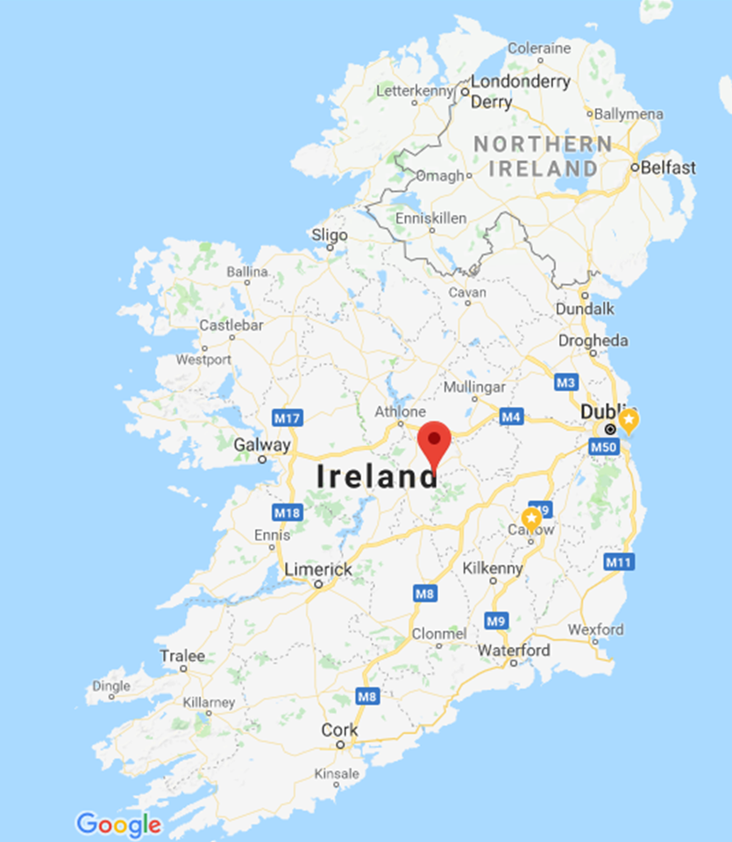
The English now knew that the rebellion had to be taken seriously & squelched decisively. When the earls appealed to the Spanish for help, the English blockaded the ships that arrived in Kinsale. The rebels marched to Kinsale (257 miles away) to assist their would-be Spanish allies, but they were defeated at the Battle of Kinsale in 1601.
Hugh O’Neill surrendered in 1603, and the English took from him & other old families land, power, & prestige. In 1607, he, the earl of Tyrconnell, & about 90 of their followers left Ireland for the continent in what came to be known as “the flight of the earls.” This event was the beginning of the end. In spite of O’Neill’s continuing attempts, from Italy, to get the Spanish to help him retake Ireland, the English had a hold on Ireland that would never be reversed, even when Ireland, centuries later, gained its freedom from England, because English customs and laws and, most importantly, the English language replaced the Gaelic ones.

Slide 6
The Plantation of Ulster
Northern Ireland & Ireland are two different countries. Northern Ireland is part of the United Kingdom of Great Britain (England, Scotland, & Wales) and Northern Ireland. The four countries have varying degrees of autonomy. That’s changed in Northern Ireland numerous times since it came into existence in 1921.
The province of Ulster consisted of 9 counties. In 1921, 6 of those 9 counties became Northern Ireland. Why Ulster? Why those 6 counties? It all began with the plantation of Ulster starting in 1609, and to this day, if you say “plantation” to a Northern Irish person, he won’t have images of a huge expanse of land planted with cotton; he’ll either have an image of his ancestors coming to settle in Ulster or an image of his ancestors having their land stolen and settled by British.
The Ulster plantation was much more successful than the earlier plantations. The earls and families who had fled had fought mostly in Ulster and were the leaders of the province, and since they had departed, there was less resistance. Also, Great Britain was more invested in the success of this plantation & poured capital into it. To maximize the investment, the city of London partnered with “captains of industry,” as it were—companies of blacksmiths, stonemasons, tailors, etc.--and established a charter for County Derry in the northwest. The merchant companies were granted land with the condition that they establish British towns in the county, which, along with Derry city, was renamed “Londonderry” in recognition of this London charter.
Having learned from past experiences, the new leaders of Ulster worked to squelch everything Gaelic. The one mistake, so to speak, was that they allowed the native Gaelic to continue living on the land that had been stolen from them, because they found cheap labor useful. The natives were Catholic, remember, & if you know anything about devout Catholicism, you know that devout Catholics don’t believe in birth control. The Irish multiplied much faster than the British, and…well, the results over 4 centuries will be discussed in the slide over the current situation in Northern Ireland.
Incidentally, the planters were primarily Scottish rather than English. Great Britain was now under one crown, remember, and today you’ll hear the term “Ulster Scots” and find that there are Americans who are of Scots-Irish descent. Actually, many of us in the South are of Scots-Irish descent.

Slide 7
Keep in mind the mix of people who now lived in Ireland. The Old English, the descendants of earlier settlers who’d persevered & remained in Ireland, held positions of importance in the governance of Ireland. But their ancestors had come during a time of Catholic-Protestant-Catholic-Protestant-etc. change, & they had been Catholic. So the Old English, in the tradition of their ancestors, were Catholic, just like the native Irish. But England had decided that Catholicism was part of the problem & that Catholics, even if they considered themselves English & loyal to the English crown, couldn’t be trusted. So James I created new positions in the Irish parliament, filled them with New English (the new settlers/colonists/planters), & thereby created a Protestant majority.
Don’t lose focus of England’s real purpose in Ireland. The English crown & nobles were interested in money, land, & power, not religion. Religion was simply a tool used for control or identification.

Slide 8
James II became king in 1685 & was the first Catholic ruler of Britain since Mary Tudor’s death in 1558. He set about changing conditions to favor Catholics, both in Great Britain & in Ireland. The Protestants grudgingly tolerated him…until his second wife produced a male heir.
The daughters of James’ first wife were Protestant, & the English nobility invited his oldest daughter, Mary, & her husband, William of Orange (a principality in what is today France, although William was Dutch), to attempt to take the throne. James didn’t just get off & allow William & Mary to ascend. For a possession that was valued just for its land & resources, Ireland saw a great deal of the ensuing war.
A walking tour of Derry inevitably includes the story of the Siege of Derry, 3 months in 1689 when James’ forces (you may read “Jacobite” forces, because the Latin word for “James” is “Jacobus”) tried to enter the Derry city walls. When the Protestant apprentice boys of Derry saw the approach of the forces, they closed & barred the gates of the city, & James’ army never succeeded in breaking through. Today Derry, although now mostly Catholic, has a Relief Parade the second Saturday in August, to celebrate the end of the siege, as well as a commemoration of “the closing of the gates” on the first Saturday in December. There are frequently other marches as well.
Another significant battle, possibly the most significant, in Ireland was the Battle of the Boyne, fought at the Boyne River near the town of Drogheda, about 23 miles north of Dublin. Before the battle was even over, James fled to France. This is another battle that is still celebrated with a parade, although the word “march” or “walk” is better. Don’t picture floats or happy music; people march solemnly in uniforms. The march is called the “Orange March” or “Orange Walk” since it celebrates the victory of the Protestant (in case you’ve lost your score card) William of Orange. The walk takes place every July 12.
At this point, you should read https://en.wikipedia.org/wiki/Orange_Order. Also, time for more critical thinking: why are Apprentice Boy marches & the Orange March still held today? Can you compare/contrast them with our own July 4th holiday?

